Slide 1
Factory Method Pattern

Slide 2
Generator Category
Consists of Creational patterns
Each generator pattern has a Client, Product, and Generator.
The Generator needs at least one operation that creates and returns the product. This is generally called a Factory Method.

Slide 3
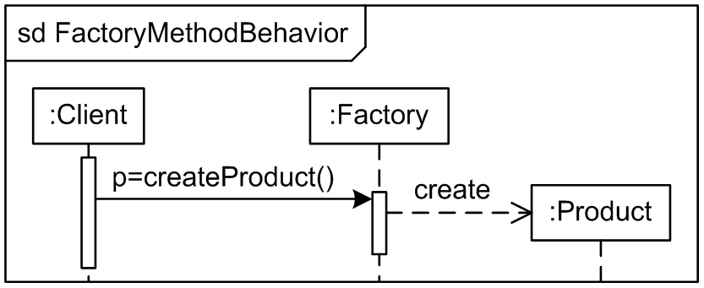
Factory Method Pattern
“Define an interface for creating an object, but let the subclasses decide which class to instantiate. The Factory method lets a class defer instantiation to subclasses.”

Slide 4
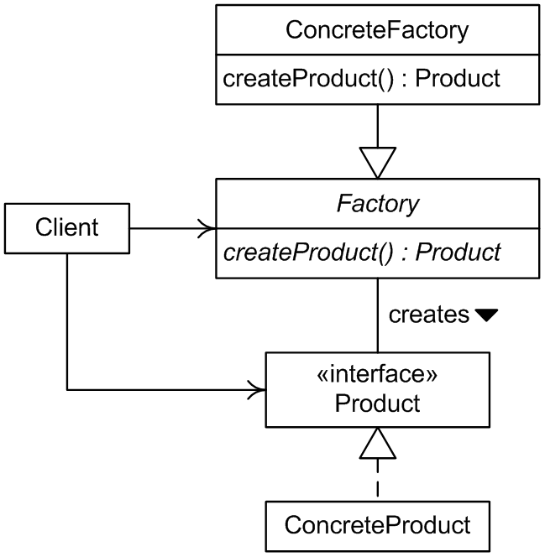
Factory Method Pattern
Applies interfaces to generalize the Product and Generator classes.
Lowers the coupling between Client and Product.

Slide 5

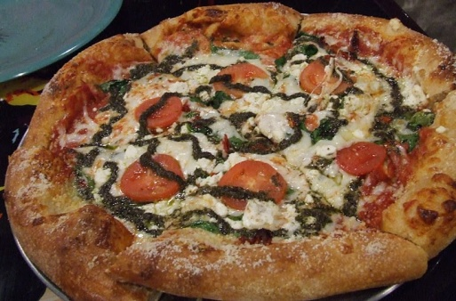
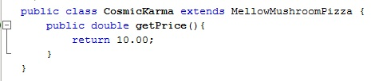
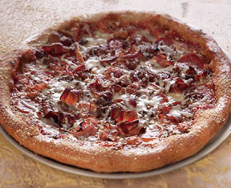

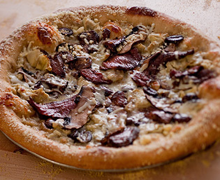

An Implementation with Pizza

Slide 6
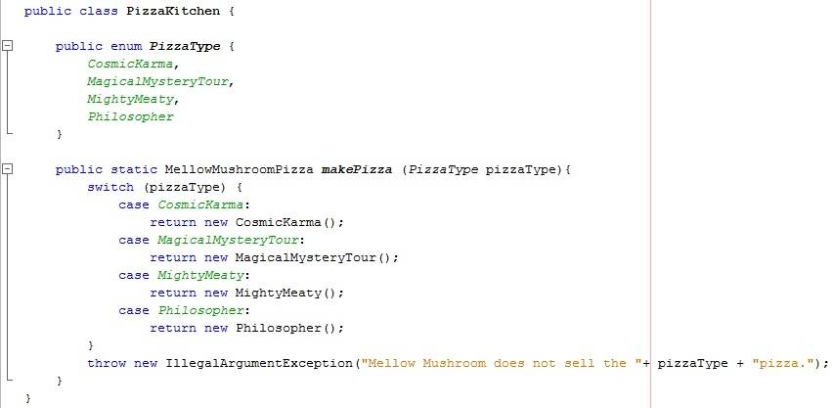
An Implementation with Pizza

Slide 7
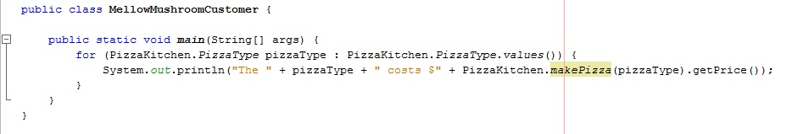
An Implementation with Pizza
The Output from this code:
The CosmicKarma costs $10.0
The MightyMeaty costs $10.5
The Philosopher costs $12.0

Slide 8
Variations
A designer could remove the abstract Factory or Product interface.
This simplifies the design, but limits aspects of pattern functionality.

